Slide 1
Can Data Science Beat the Stock Market Game?
By: Gatlin Willis
Johana Aleman

Slide 2




Gatlin’s Background
Education
Master’s in Business Administration
Bachelor’s in Business Administration
Majored in Finance and Accounting
Work Experience
Graduate Assistant at the University of Tennessee at Martin
Intern at Cowart Reese Sargent, CPAs, P.C.
Data Entry Specialist at Carey Counseling Center – Current

Slide 3





Johana’s Background
Education
Master In Business Administration with Major in Finance
(Magna Cum Laude)
Bachelor in Computer Science
Work Experience
Senior SQL Developer at UNFI – Current
SSRS Report Developer at CSS Global Tech
Software Developer at Secretary of Education, Honduras

Slide 4


Project Overview
The Stock Market since September 2019
An overview of the S&P 500 performance
An overview of the Market Sectors performance
Analysis of Five Public Companies
An overview of our stock picks and their competitors since September 2019
An overview of our stock picks and their competitors’ rate of returns
Use Moving Averages to determine stocks trends
Simple Moving Average (SMA)
Implement a forecasting model using LSTM networks in Keras
Use 80% of the data as train and 20% test to build the model
Predict the Price of these 5 stocks 30 days in the Future

Slide 5

Methodology
Pulled data using Yahoo Finance API
Created a data frames of the adjusted closing price for the index, sectors, and companies
Data exploration
Data wrangling for rate of returns
Plotted the data
Long Short Term Methodology (LSTM) Network

Slide 6
Stock Market
Stock Market Index
Used to measure performance
Top 3 US Stock Market Indexes:
National Association of Securities Dealers Automated Quotations (NASDAQ)
Dow Jones Industrial Average (Dow)
Standards and Poor’s 500 (S&P 500)
Observation: S&P 500 Adjusted Closing Price from 9/3/2019 to 9/17/2021

Slide 7

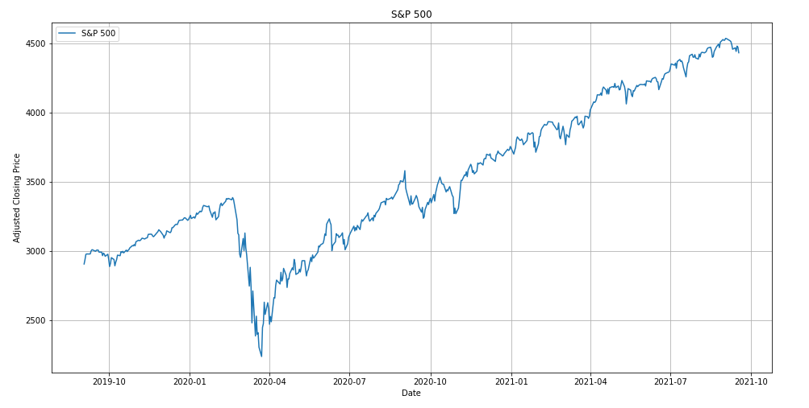
Historic Performance
4432
9/17/21
3386
2/19/20
3389
8/18/20
2906
9/3/19
2237
3/23/20

Slide 8
Stock Market
Stock Market Sectors
Stocks that are common with each other due to being in similar industries
11 different stock market sectors, according the Global Industry Classification Standard (GICS)
Sector exchange-traded fund (ETF) - invests specifically in the stocks and securities of a particular industry/sector
Observation: 11 ETFs Adjusted Closing Price from 9/3/2019 to 9/17/2021

Slide 9
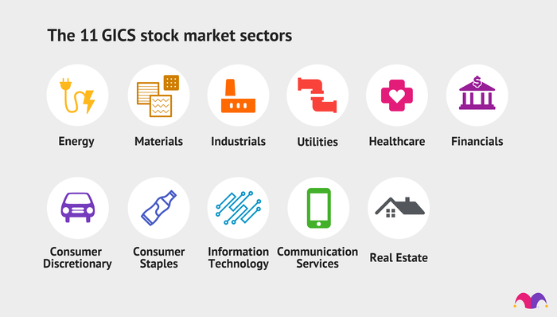
Stock Market Sectors

Slide 10
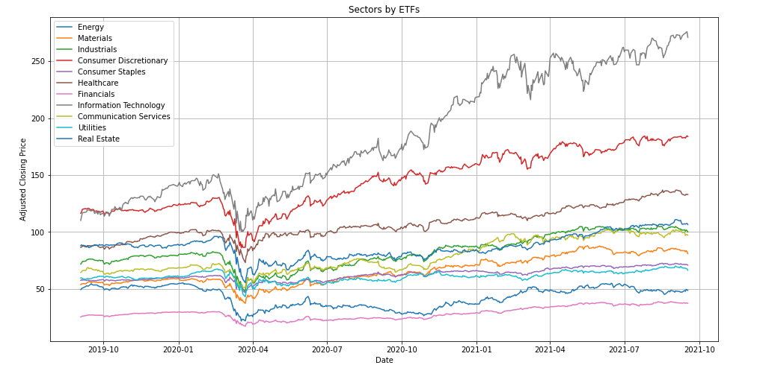
Stock Market Sectors Performance

Slide 11
Our Stock Picks
Our Five Companies
Apple
Amazon
Coca-Cola
Alphabet, Inc. (Google)
Ford
Observation: Compare these companies with their competitors and appropriate sector (ETF) based on Adjusted Closing Price (9/3/19-9/17/21)
Observation: Compare these companies with their competitors based on Rate of Return and Gains/Loses from 8/23/21 to 9/17/21

Slide 12


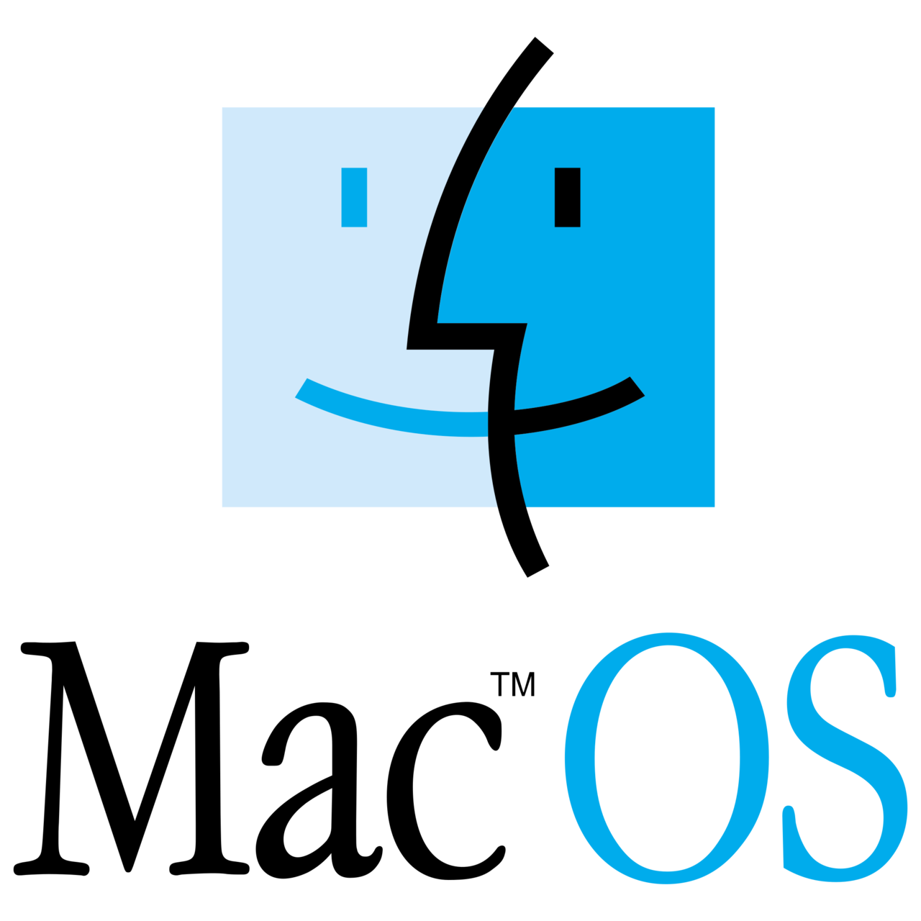



Apple vs. Microsoft

Slide 13
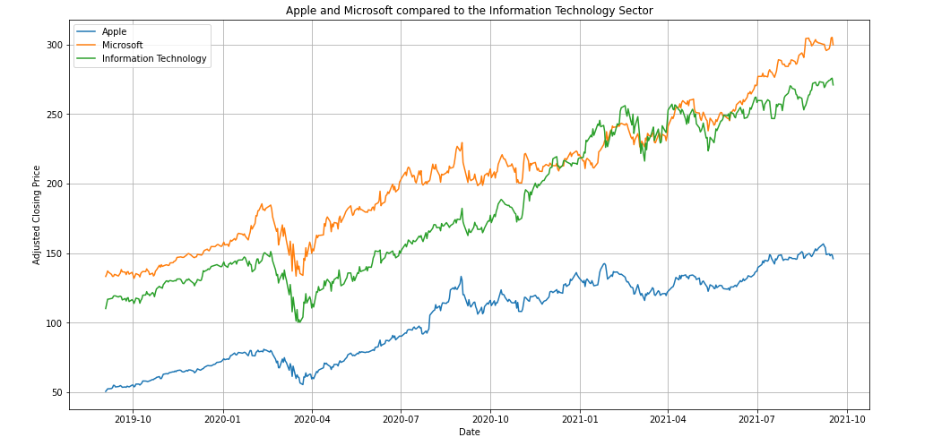
Apple vs. Microsoft

Slide 14
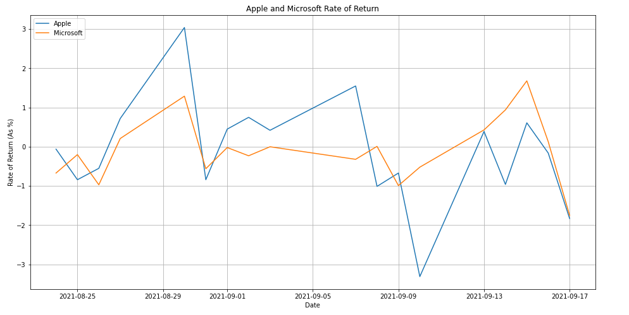
Apple vs. Microsoft

Slide 15
Apple vs. Microsoft
Apple (AAPL)
Microsoft (MSFT)
Starting price: 08-23-2021 149.71
Ending price: 09-17-2021 146.06 (-3.65)
Biggest gain: 08-30-2021 +4.52 (+3.04%)
Biggest loss: 09-10-2021 -5.10 (-3.31%)
Starting price: 08-23-2021 304.65
Ending price: 09-17-2021 299.87 (-4.78)
Biggest gain: 09-15-2021 +5.03 (+1.68%)
Biggest loss: 09-17-2021 -5.35 (-1.75%)

Slide 16






Amazon vs. Alibaba

Slide 17
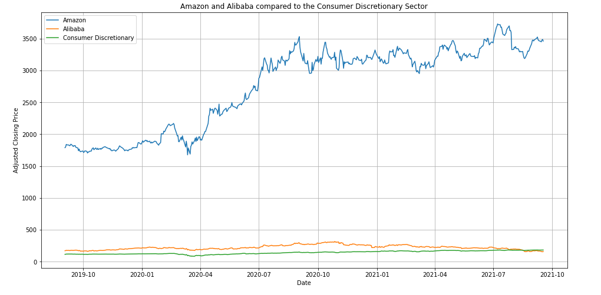
Amazon vs. Alibaba

Slide 18
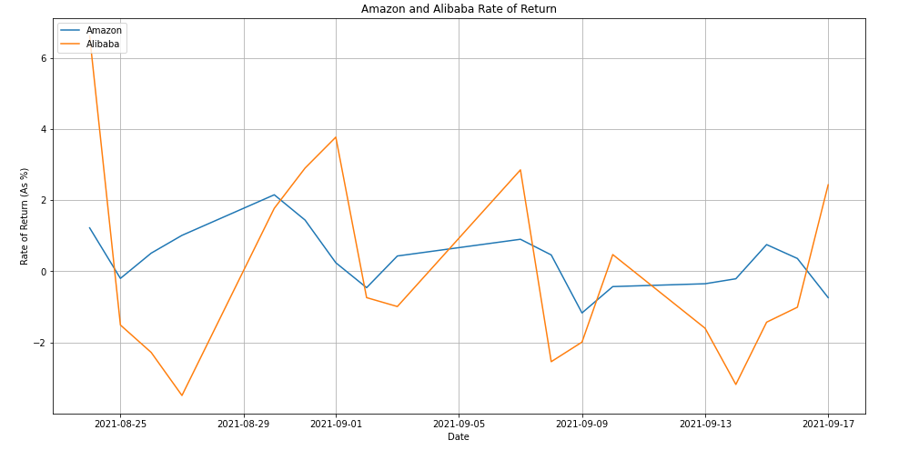
Amazon vs. Alibaba

Slide 19
Amazon vs. Alibaba
Amazon (AMZN)
Alibaba (BABA)
Starting price: 08-23-2021 3265.87
Ending price: 09-17-2021 3462.52 (+196.65)
Biggest gain: 08-30-2021 +71.94 (+2.15%)
Biggest loss: 09-09-2021 -41.34 (-1.17%)
Starting price: 08-23-2021 161.06
Ending price: 09-17-2021 160.05 (-1.01)
Biggest gain: 08-24-2021 +10.64 (+6.61%)
Biggest loss: 08-27-2021 -5.77 (-3.49%)

Slide 20



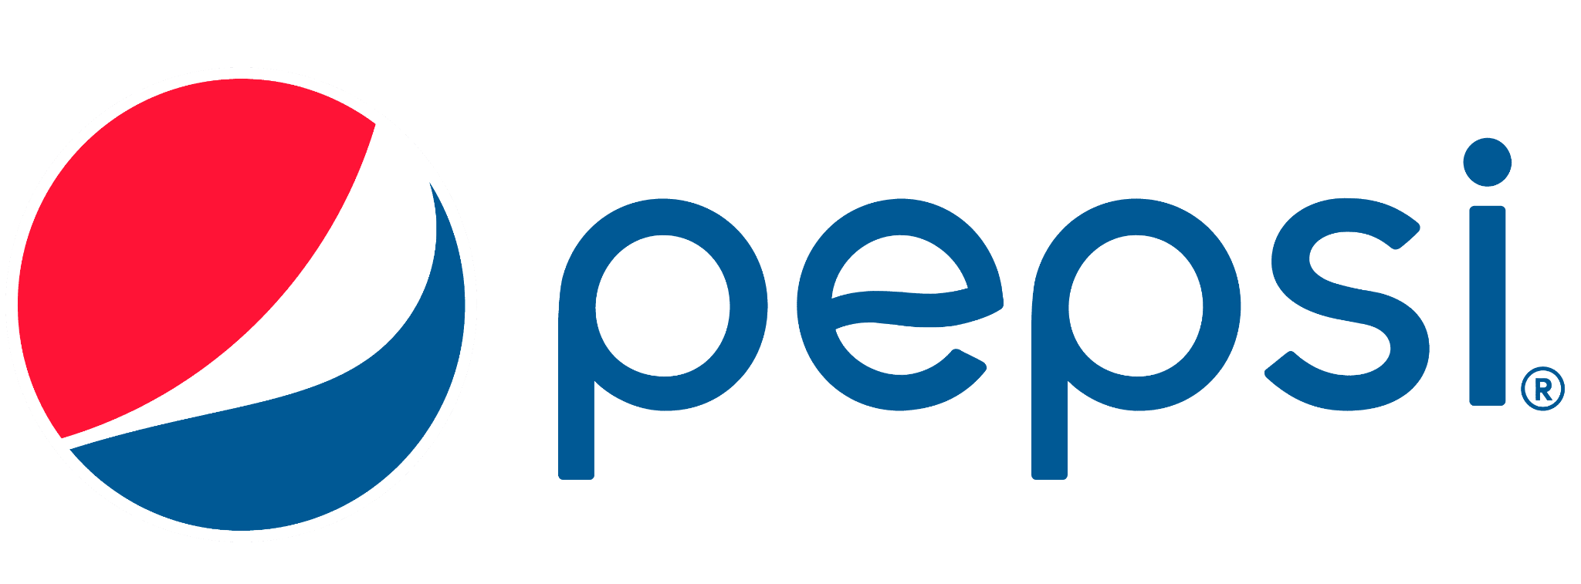
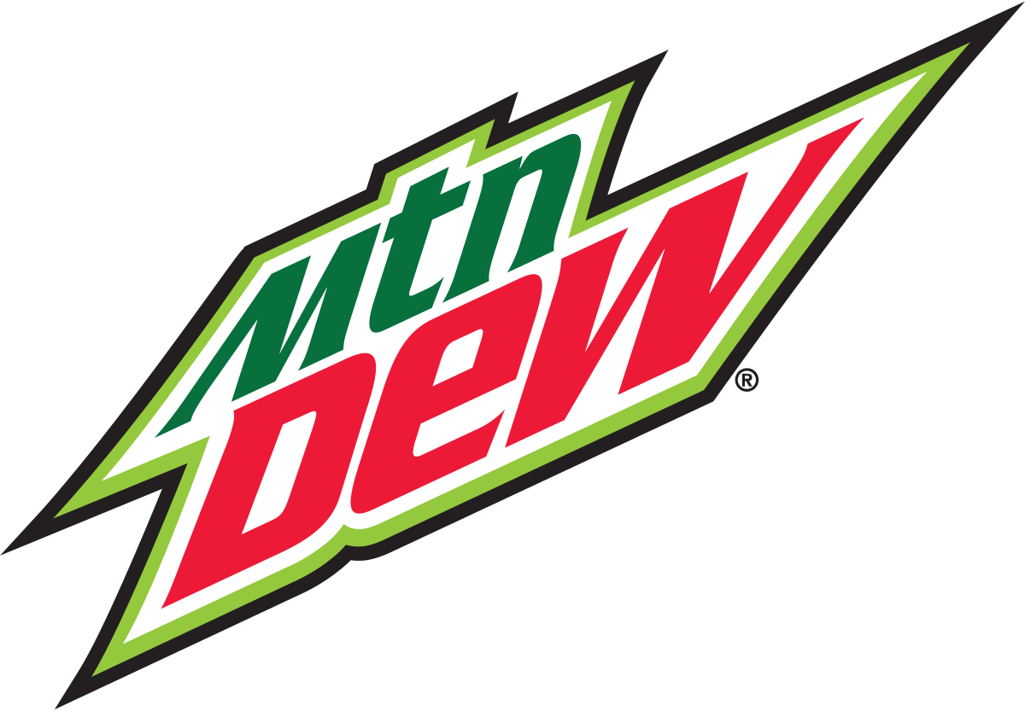
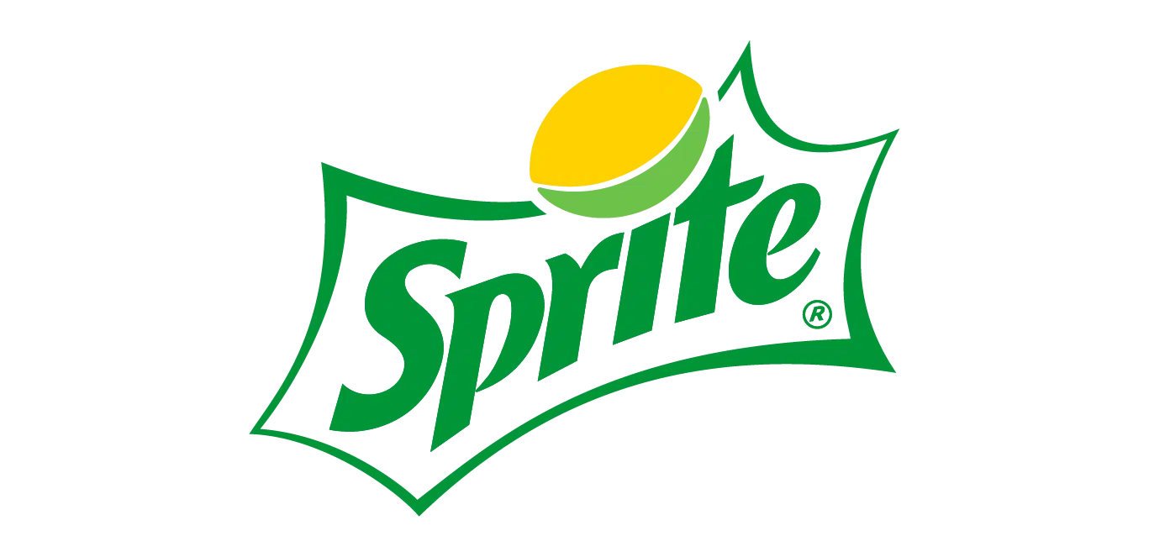
Coca-Cola vs. Pepsi

Slide 21
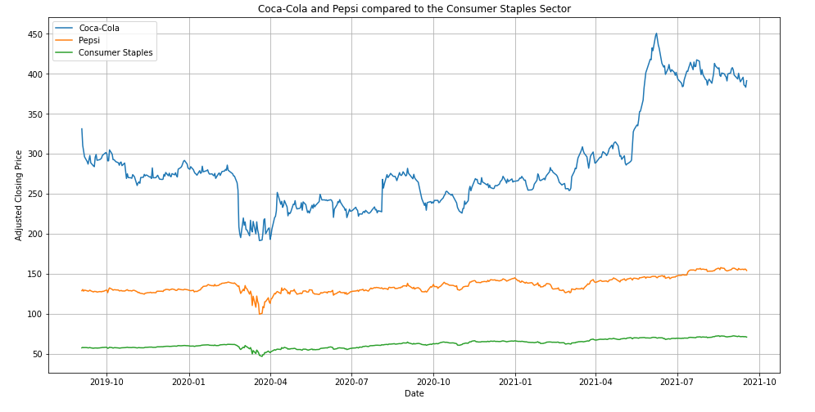
Coca-Cola vs. Pepsi

Slide 22
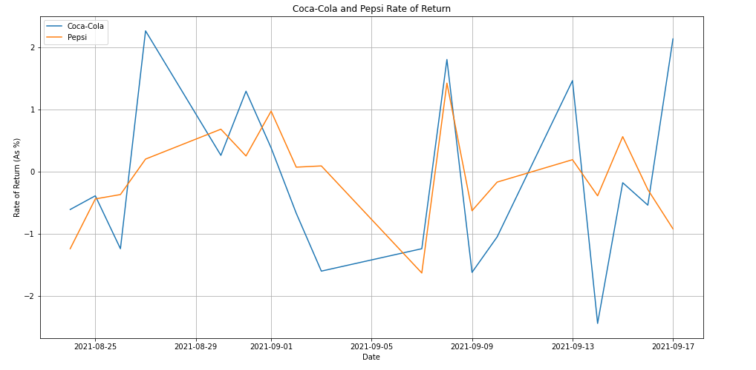
Coca-Cola vs. Pepsi

Slide 23
Coca-Cola vs. Pepsi
Coca-Cola Consolidated (COKE)
PepsiCo (PEP)
Starting price: 08-23-2021 400.00
Ending price: 09-17-2021 391.43 (-8.57)
Biggest gain: 08-27-2021 +8.85 (2.26%)
Biggest loss: 09-14-2021 -9.67 (2.44%)
Starting price: 08-23-2021 156.78
Ending price: 09-17-2021 154.13 (-2.65)
Biggest gain: 09-08-2021 +2.19 (+1.42%)
Biggest loss: 09-07-2021 -2.56 (-1.63%)

Slide 24





Alphabet (Google) vs. Microsoft

Slide 25
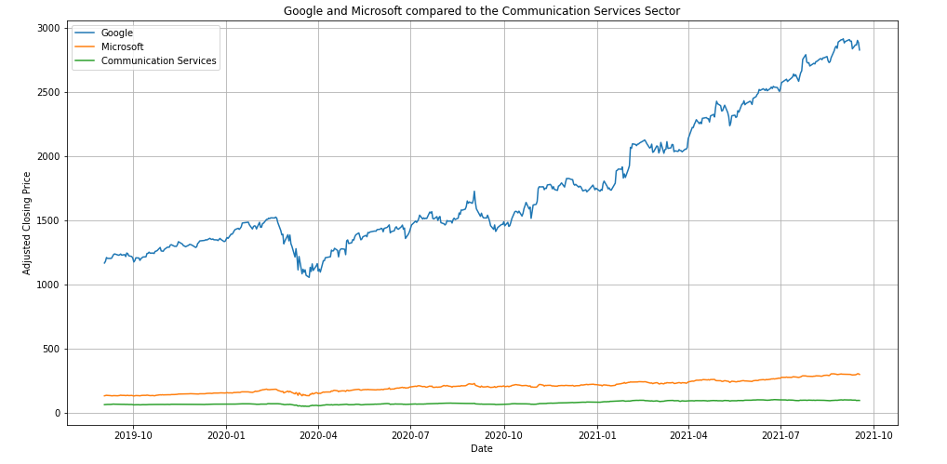
Alphabet, Inc. (Google) vs. Microsoft

Slide 26
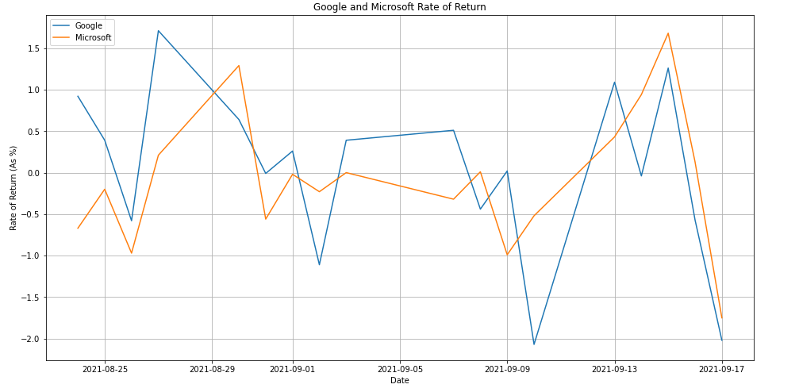
Alphabet, Inc. (Google) vs. Microsoft

Slide 27
Alphabet, Inc. (Google) vs. Microsoft
Alphabet, Inc. (GOOG)
Microsoft (MSFT)
Starting price: 08-23-2021 2821.99
Ending price: 09-17-2021 2829.27 (+7.28)
Biggest gain: 08-27-2021 +48.55 (1.71%)
Biggest loss: 09-10-2021 -59.85 (-2.07%)
Starting price: 08-23-2021 304.65
Ending price: 09-17-2021 299.87 (-4.78)
Biggest gain: 09-15-2021 +5.03 (+1.68%)
Biggest loss: 09-17-2021 -5.35 (-1.75%)

Slide 28





Ford vs. General Motors

Slide 29
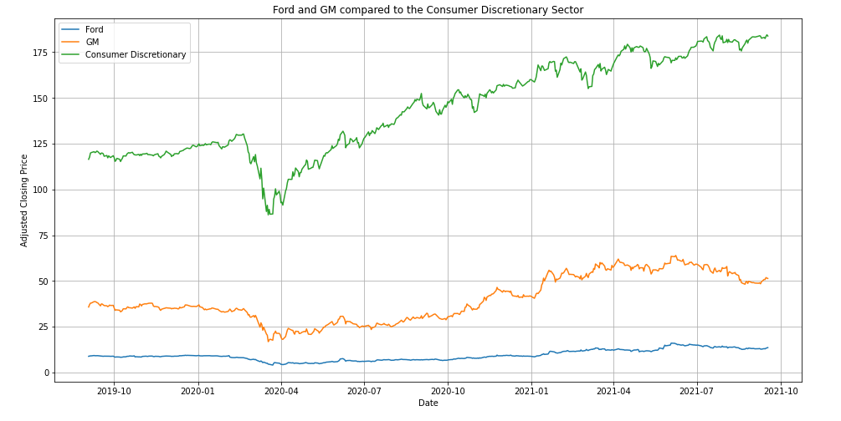
Ford vs. General Motors

Slide 30
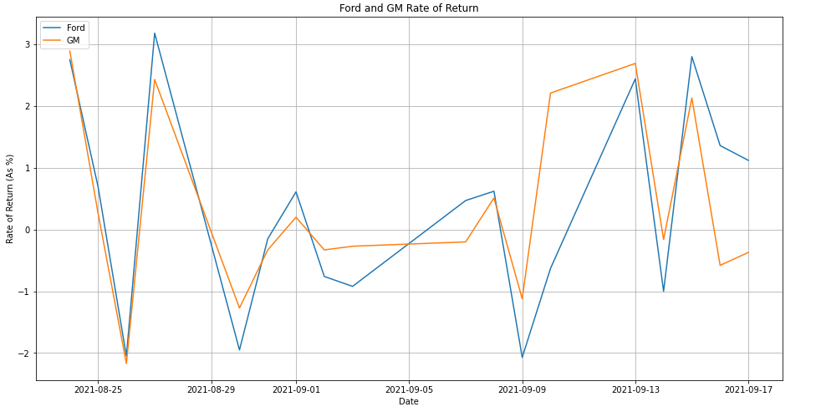
Ford vs. General Motors

Slide 31
Ford vs. General Motors
Ford (F)
General Motors (GM)
Starting price: 08-23-2021 12.73
Ending price: 09-17-2021 13.55 (+0.82)
Biggest gain: 08-27-2021 +0.41 (+3.18%)
Biggest loss: 09-09-2021 -0.27 (-2.07%)
Starting price: 08-23-2021 48.18
Ending price: 09-17-2021 51.33 (+3.15)
Biggest gain: 08-24-2021 +1.39 (+2.89%)
Biggest loss: 08-26-2021 -1.08 (-2.17%)

Slide 32


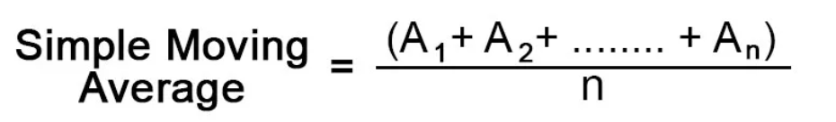


Moving Averages
Formula
Help to determine:
Up Trend
Signal
Down Trend
Signal

Slide 33
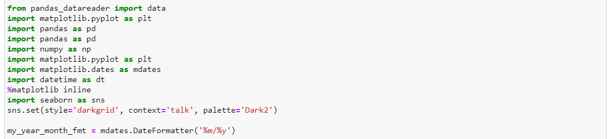
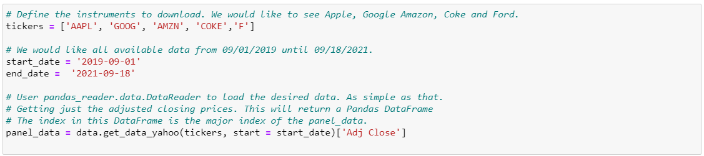
Getting the Data
Import Libraries

Slide 34
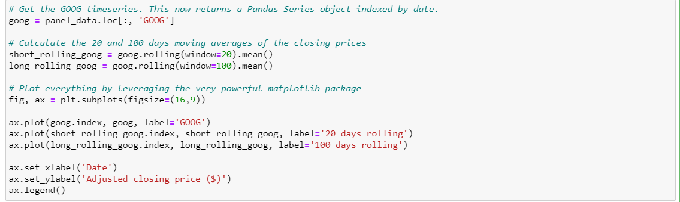
Stock behavior compared to a short and longer term moving average of its Close Price
A simple moving average of the original time-series is calculated by taking for each date the average of the last W prices (including the price on the date of interest). pandas has rolling(), a built in function for Series which returns a rolling object for a user-defined window, e.g. 20 days.

Slide 35

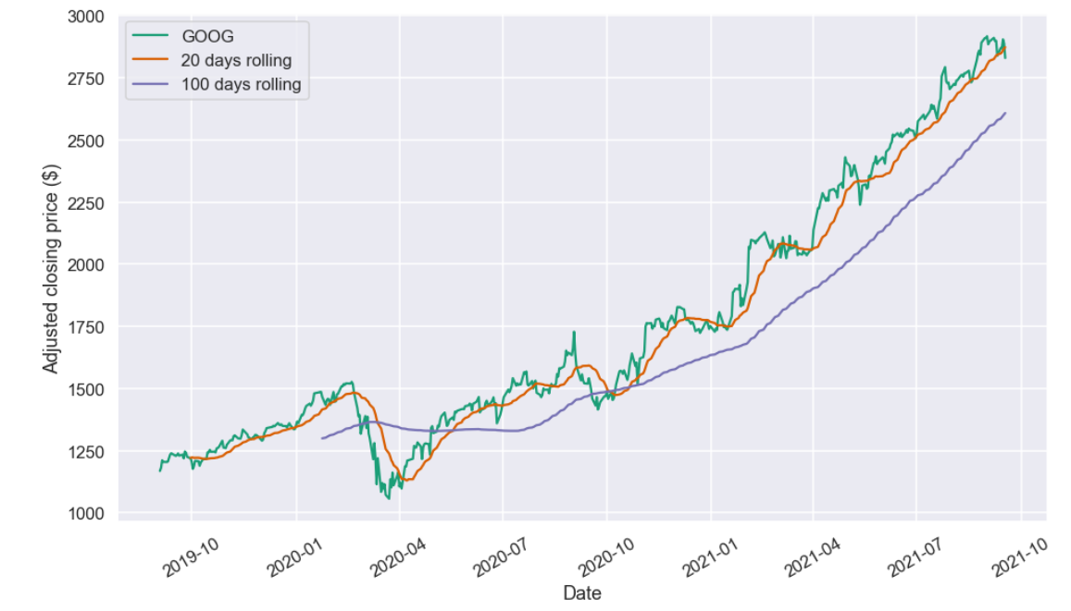
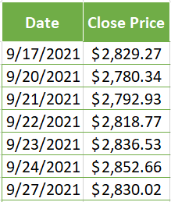
An Moving Average (MA) with a short time frame will react much quicker to price changes than an MA with a long look back period. The 20-day may be of analytical benefit to a shorter-term trader since it follows the price more closely and therefore produces less "lag" than the longer-term moving average. A 100-day MA may be more beneficial to a longer-term trader

Slide 36

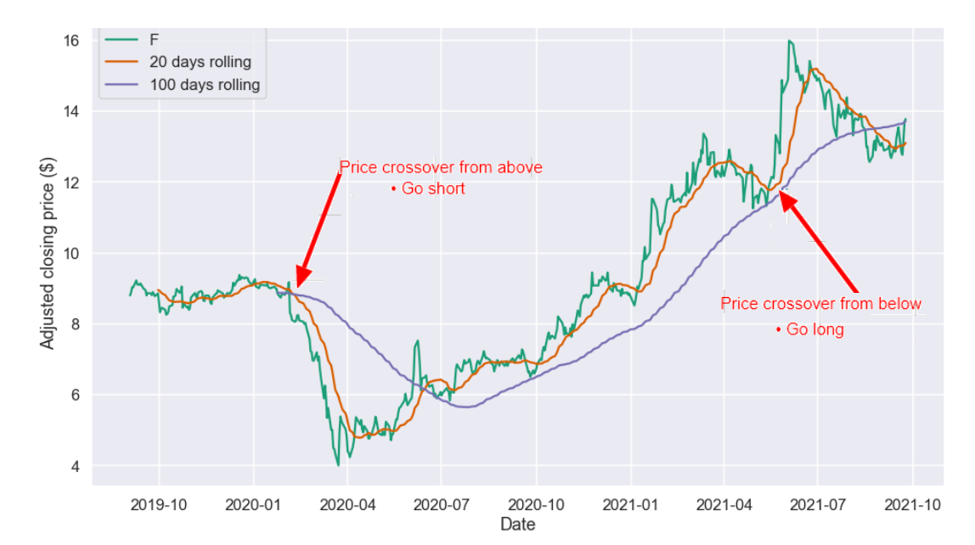
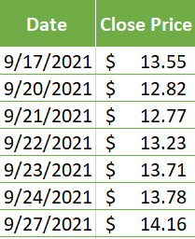
Buy low and Sell high. Go long(Buy), Go Short(Sell)

Slide 37

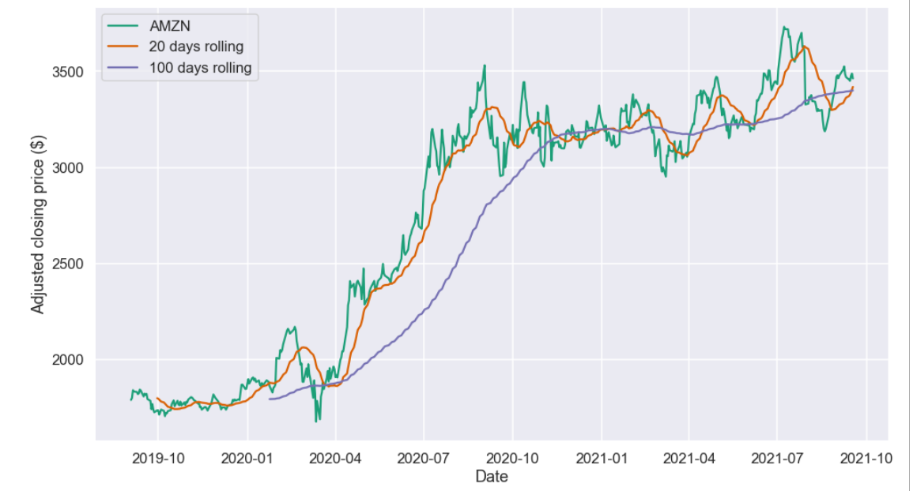
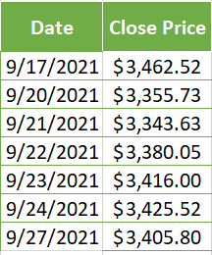

Slide 38

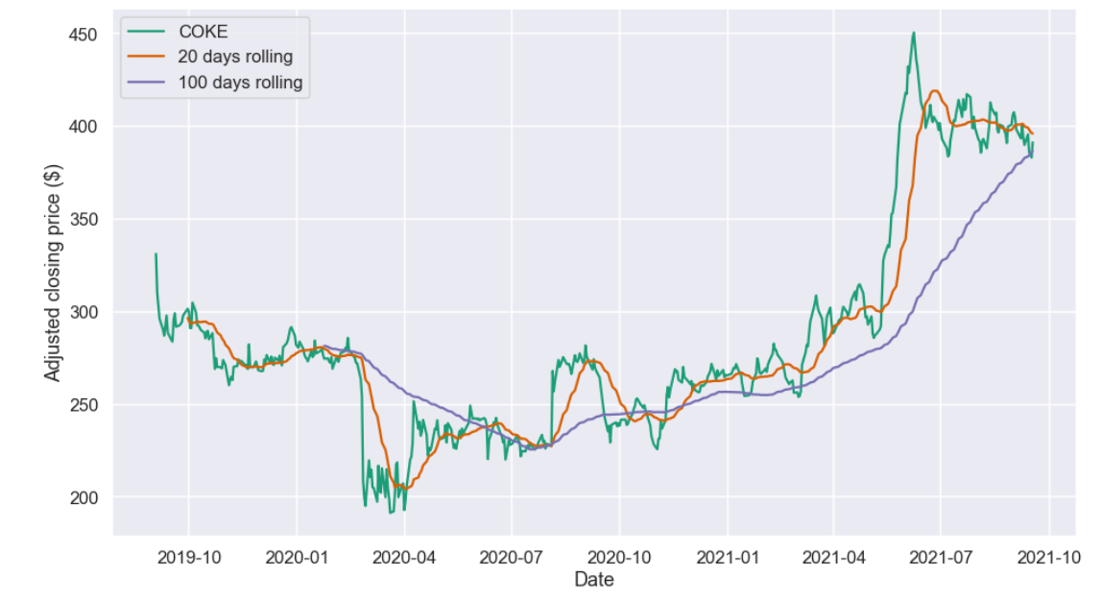
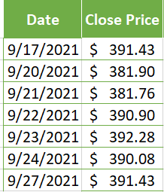

Slide 39

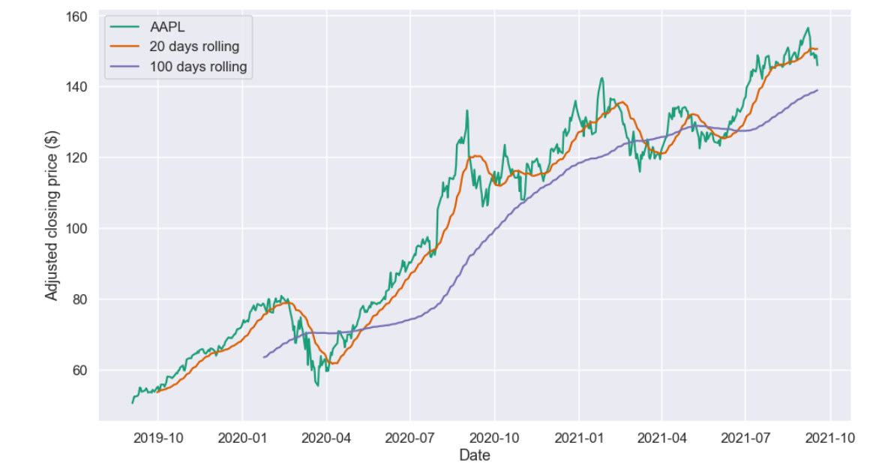
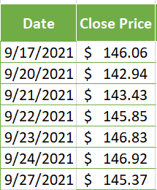

Slide 40
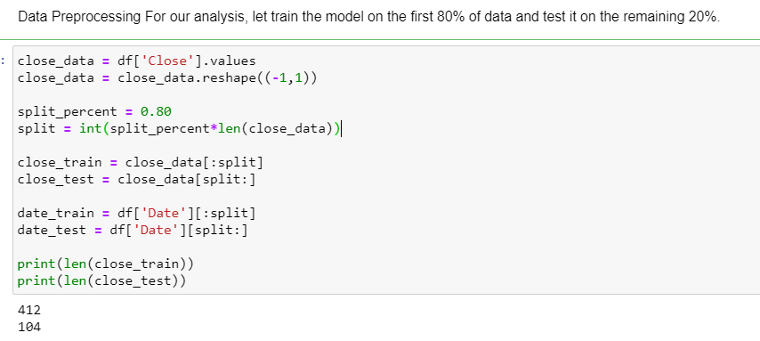
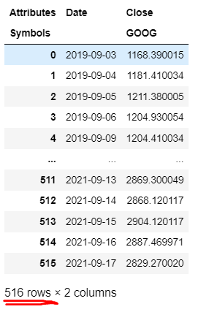
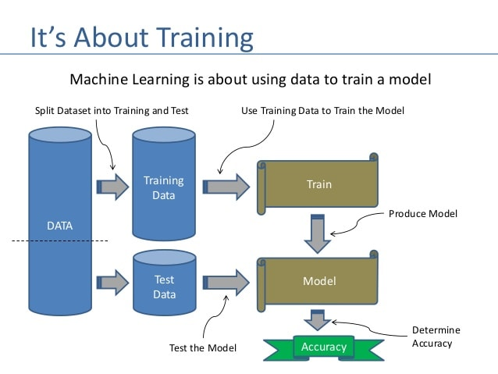
Overview: Forecasting using LSTM networks

Slide 41
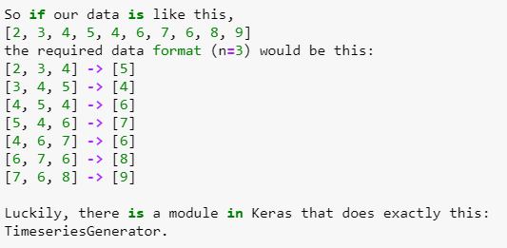
Wrangling the Data to be accepted by the Model
Before we do the training, we need to do some major modification to our data. Remember, our data is still a sequence.. a list of numbers. The neural network is trained as a supervised model. Thus we need to convert the data from sequence to supervised data
Training a neural network of any machine learning model requires the data to be in {,} format. Similarly, we need to convert the given data into this format. Here, we introduce a concept of a look back. Look back is nothing but the number of previous days’ data to use, to predict the value for the next day. For example, let us say look back is 2; so in order to predict the stock price for tomorrow, we need the stock price of today and yesterday.
Coming back to the format, at a given day x(t), the features are the values of x(t-1), x(t-2), …., x(t-n) where n is look back.

Slide 42
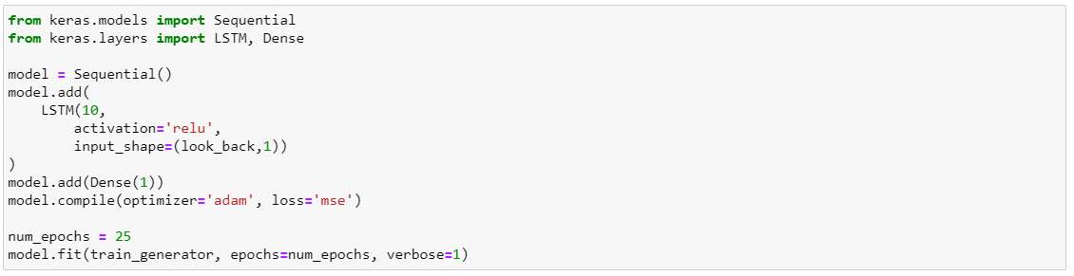
Building LSTM Network
15 is the number of previous days’ data to use, to predict the value for the next day
creating and training our network.
A simple architecture of LSTM units trained using Adam optimizer and Mean Squared Loss function for 25 epochs

Slide 43
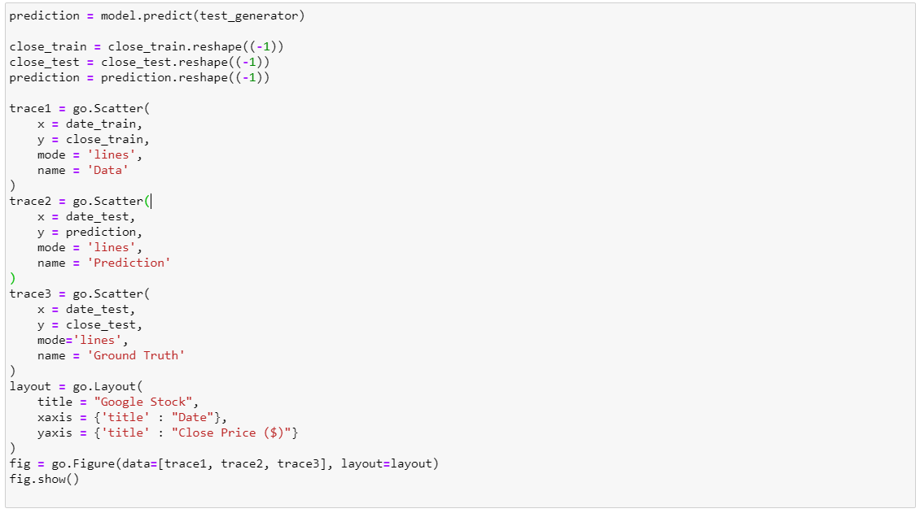
Prediction
Now that we have completed training, let us see if the network performed well. We can test the model on testing data and see if the prediction and the actual values overlap.

Slide 44
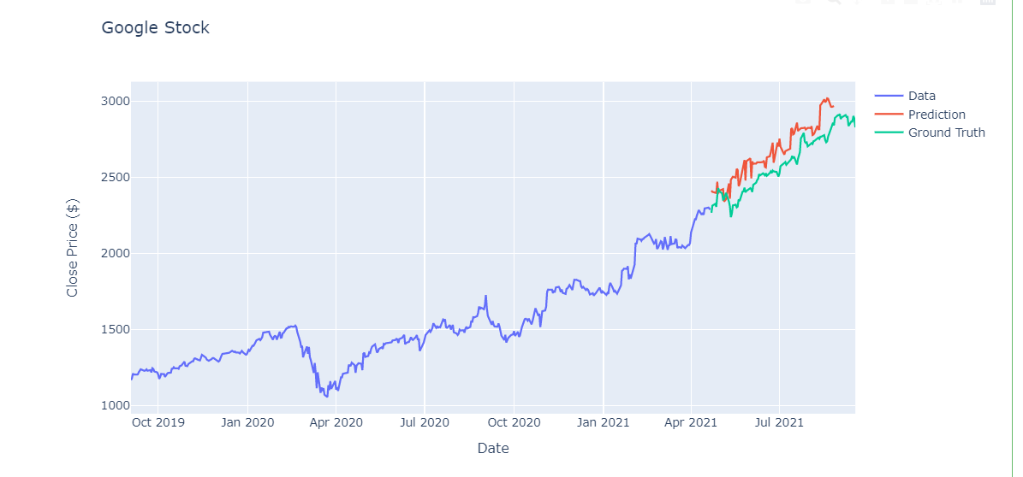
From the graph, we can see that prediction and the actual value(ground truth) somewhat overlap. But if you zoom in, the fit is not perfect. We should expect this because it is inevitable as we are performing prediction. Forecasting Our testing shows the model is somewhat good. So we can move on to predicting the future or forecasting.

Slide 45
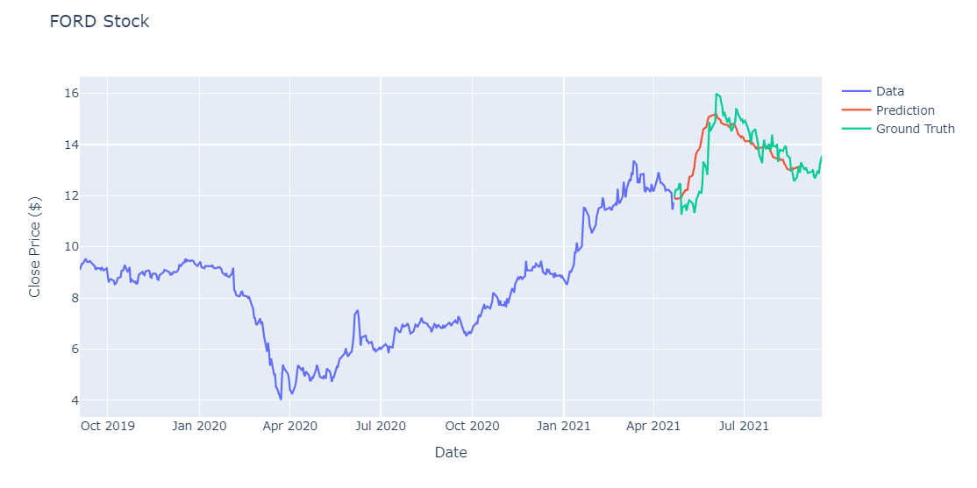

Slide 46
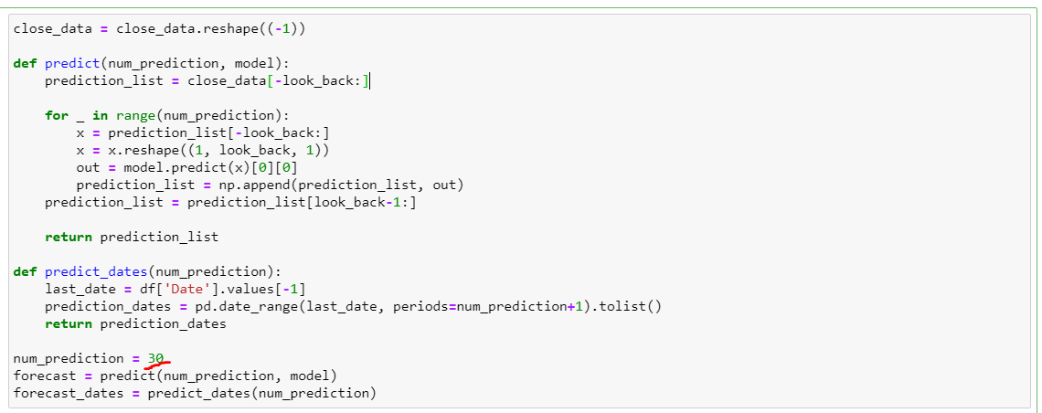
Predicting the Future
Forecasting for longer duration is not feasible. So, let’s forecast a months stock price.

Slide 47
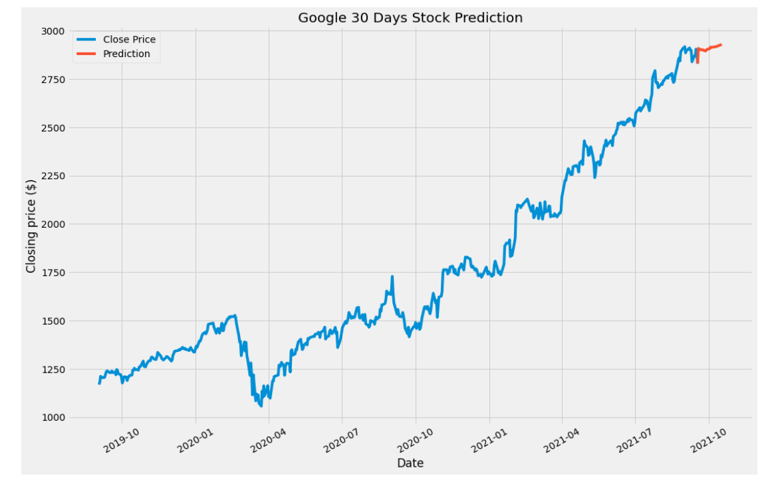
OOG 30 Days Forecasting

Slide 48
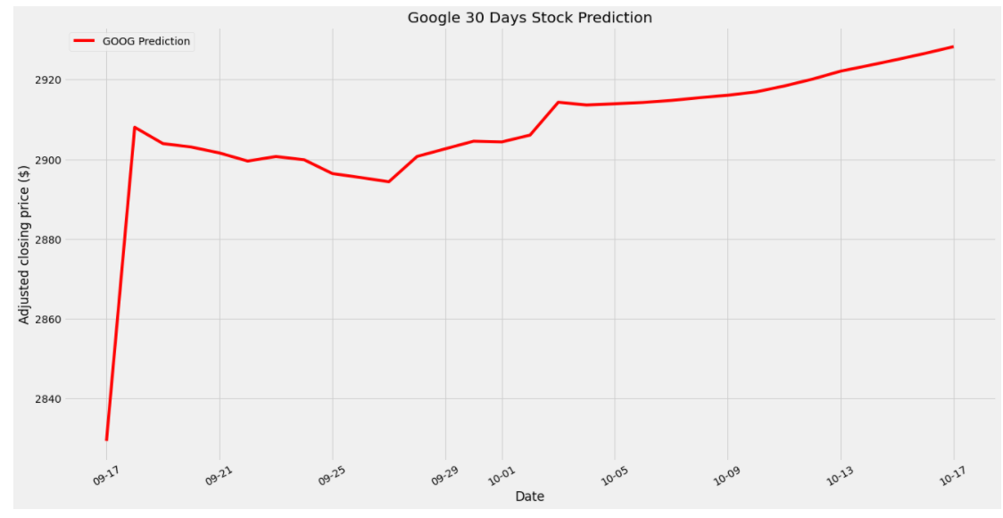
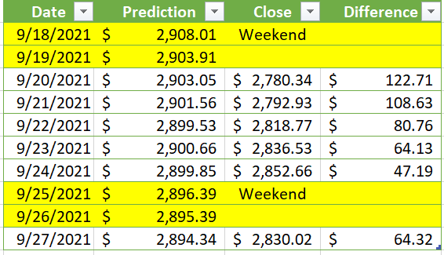
Close up to GOOG 30 Days Forecasting

Slide 49
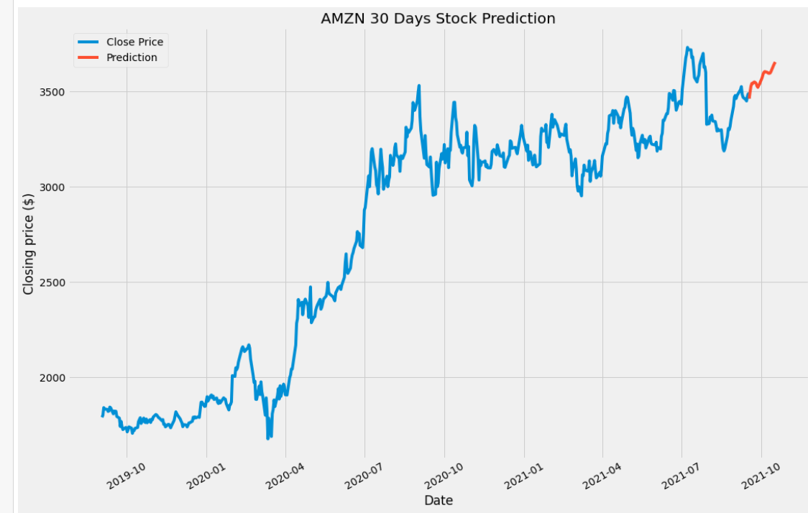
30 Days Forecasting

Slide 50
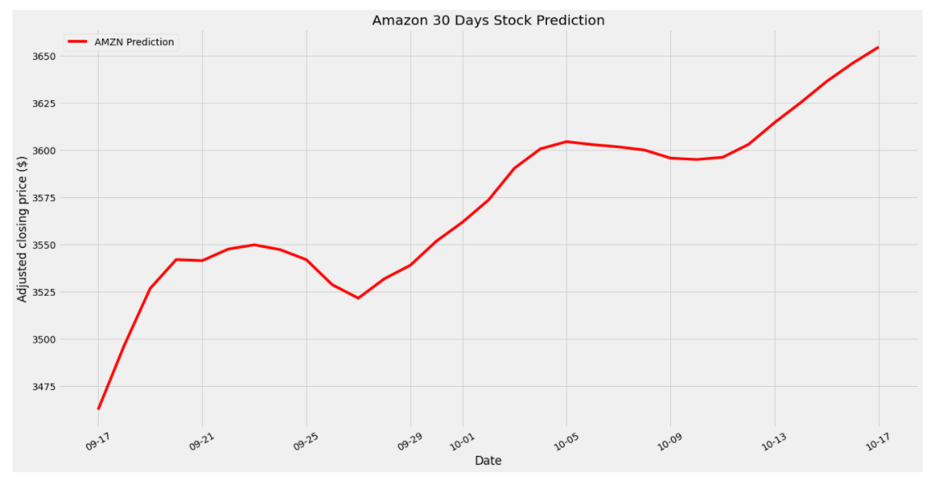
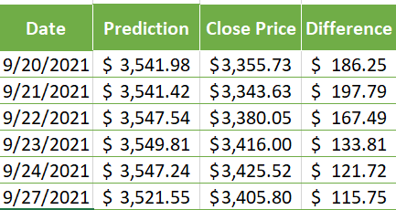
Close up to AMZN 30 Days Forecasting

Slide 51
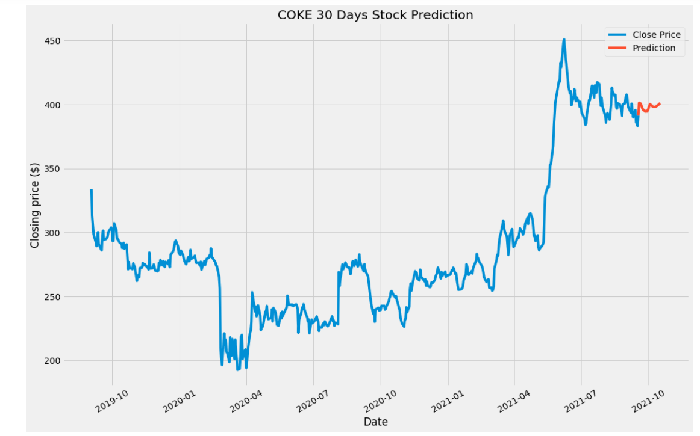
30 Days Forecasting

Slide 52
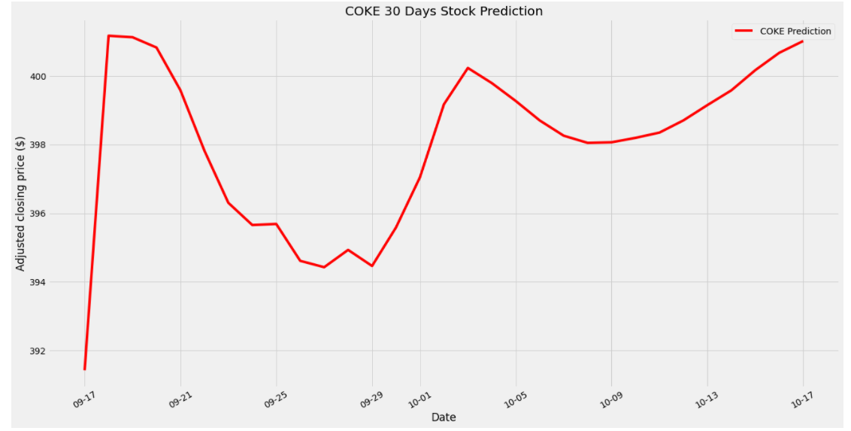
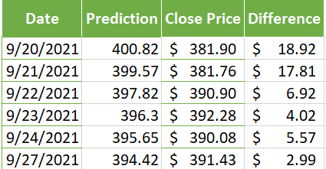
Close up to COKE 30 Days Forecasting

Slide 53
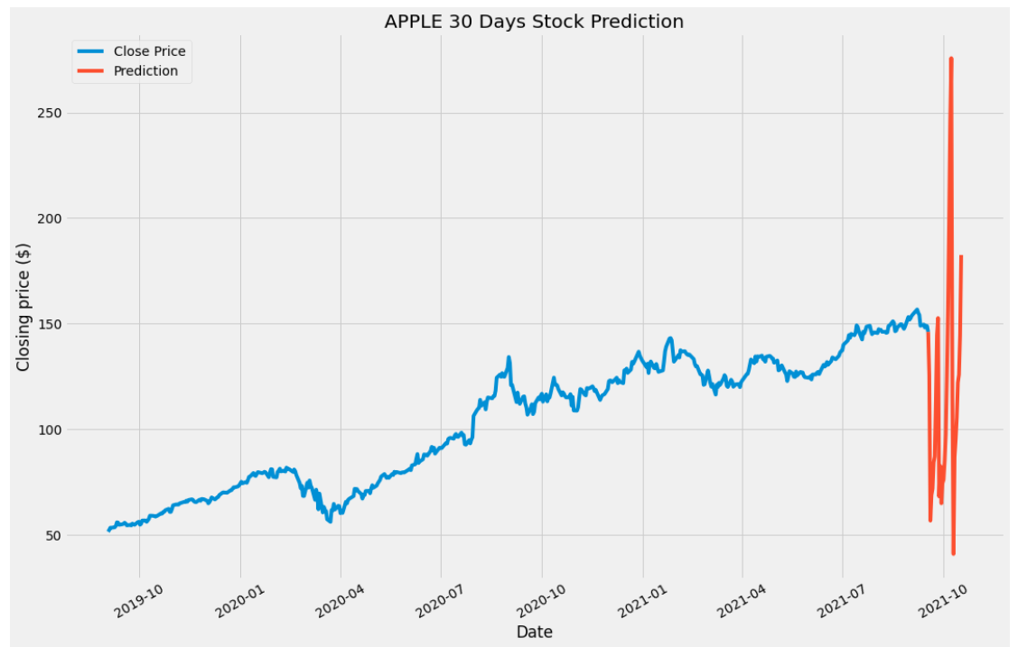
30 Days Forecasting

Slide 54


Close up to APPLE 30 Days Forecasting

Slide 55

30 Days Forecasting

Slide 56


Close up to FORD 30 Days Forecasting

Slide 57


Portafolio Return
Assuming our Portafolio have the 5 stocks that we forecasted (AMZN, AAPL, GOOG, F, COKE), we are wanted to know the yearly return average

Slide 58
Summary
In this project, technical analysis was used to study the price movement and patterns of a stock. By scrutinizing a stock's past price action, primarily through charts and indicators, traders try to forecast future price direction.
Nowadays, many companies use algorithms to predict the movement of the stock price, trying to beat the market. In this project, primitive predictions, such as Technical Analysis and Simple Moving Average (SMA), was compared with more sophisticated models such as Long Short Term Model(LSTM) network predictions using python packages like Keras, LSTM.
Base in our project, we were able to find some trends that could help make better decisions when trying to invest in the stock market, but we will need to add more indicators to have a complete picture.

Slide 59

Conclusions
Can Data Science beat the stock market game? It is not a simple question to answer at this point, because new metrics need to be defined in order to answer this question.
It is straightforward to observe Simple Moving Average (SMA) timeseries that are much less noisy than the original price timeseries. However, this comes at a cost: SMA timeseries lag the original price timeseries, which means that changes in the trend are only seen with a delay (lag) of the number of days.
With LSTM Network, we have created a basic model that is able to forecast to a certain extent. Even though the model is not perfect, we have one that can approximate to the past data pretty well. But for new data, we would require more parameter tuning.

